Slide 1
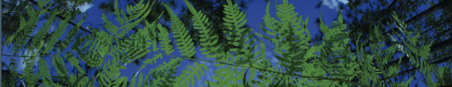

Workshop Setup
University of Florida

Slide 2
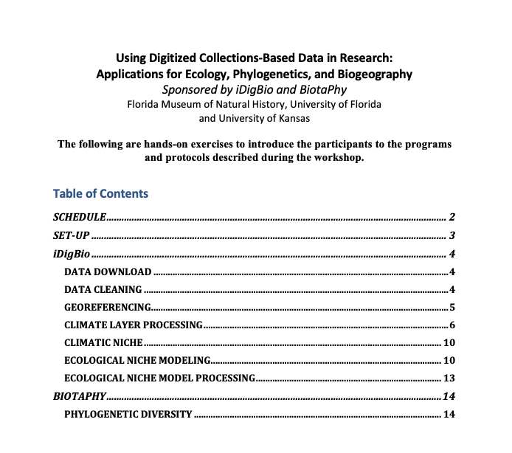
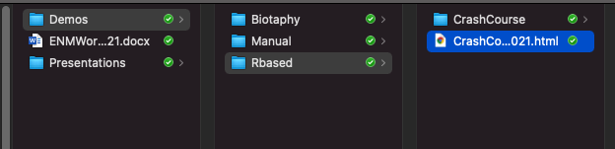
Workshop setup
Workshop Guide
Questions should be added here
during the workshop:
https://tinyurl.com/6fckt5j3

Slide 3
Workshop setup
HTML Version of all R scripts

Slide 4
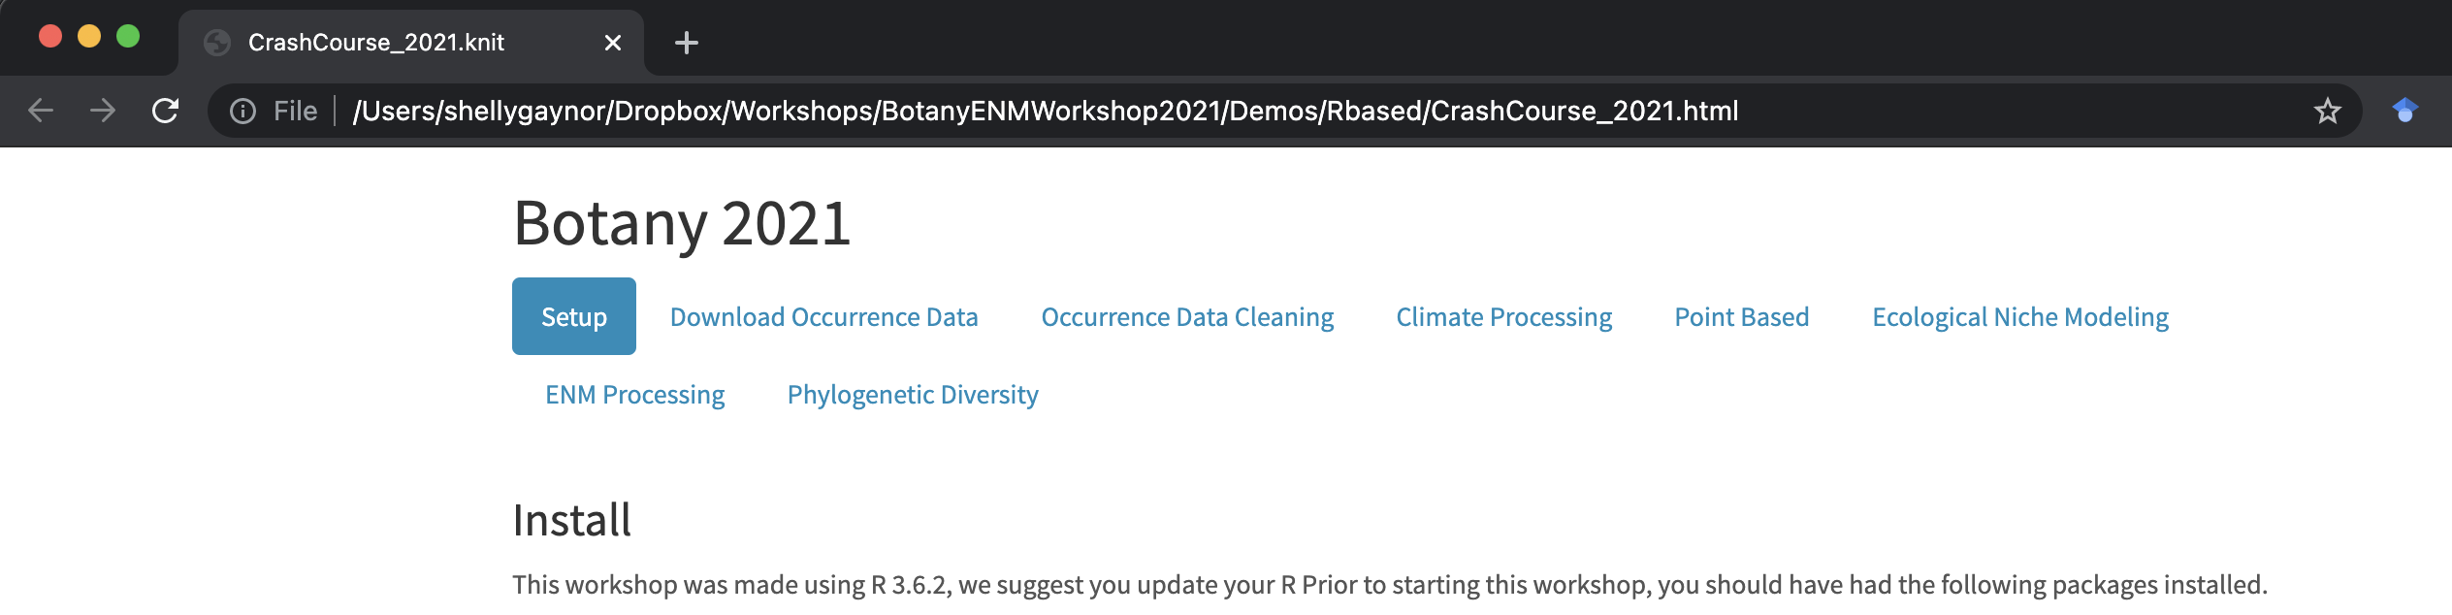
Workshop setup
Contains additional troubleshooting steps
Notes:
Great way to follow along during the workshop!

Slide 5
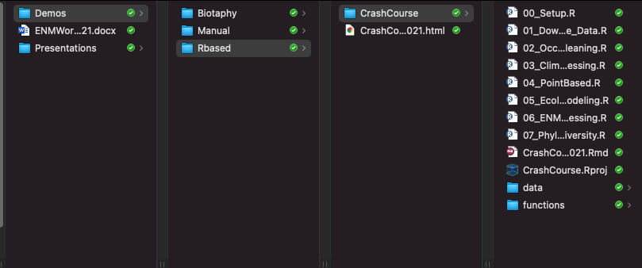
Workshop setup
Opens the R project

Slide 6
Workshop setup
Run before the workshop started!
How the R project was made
All data and functions needed for these scripts

Slide 7
Data Download
University of Florida

Slide 8
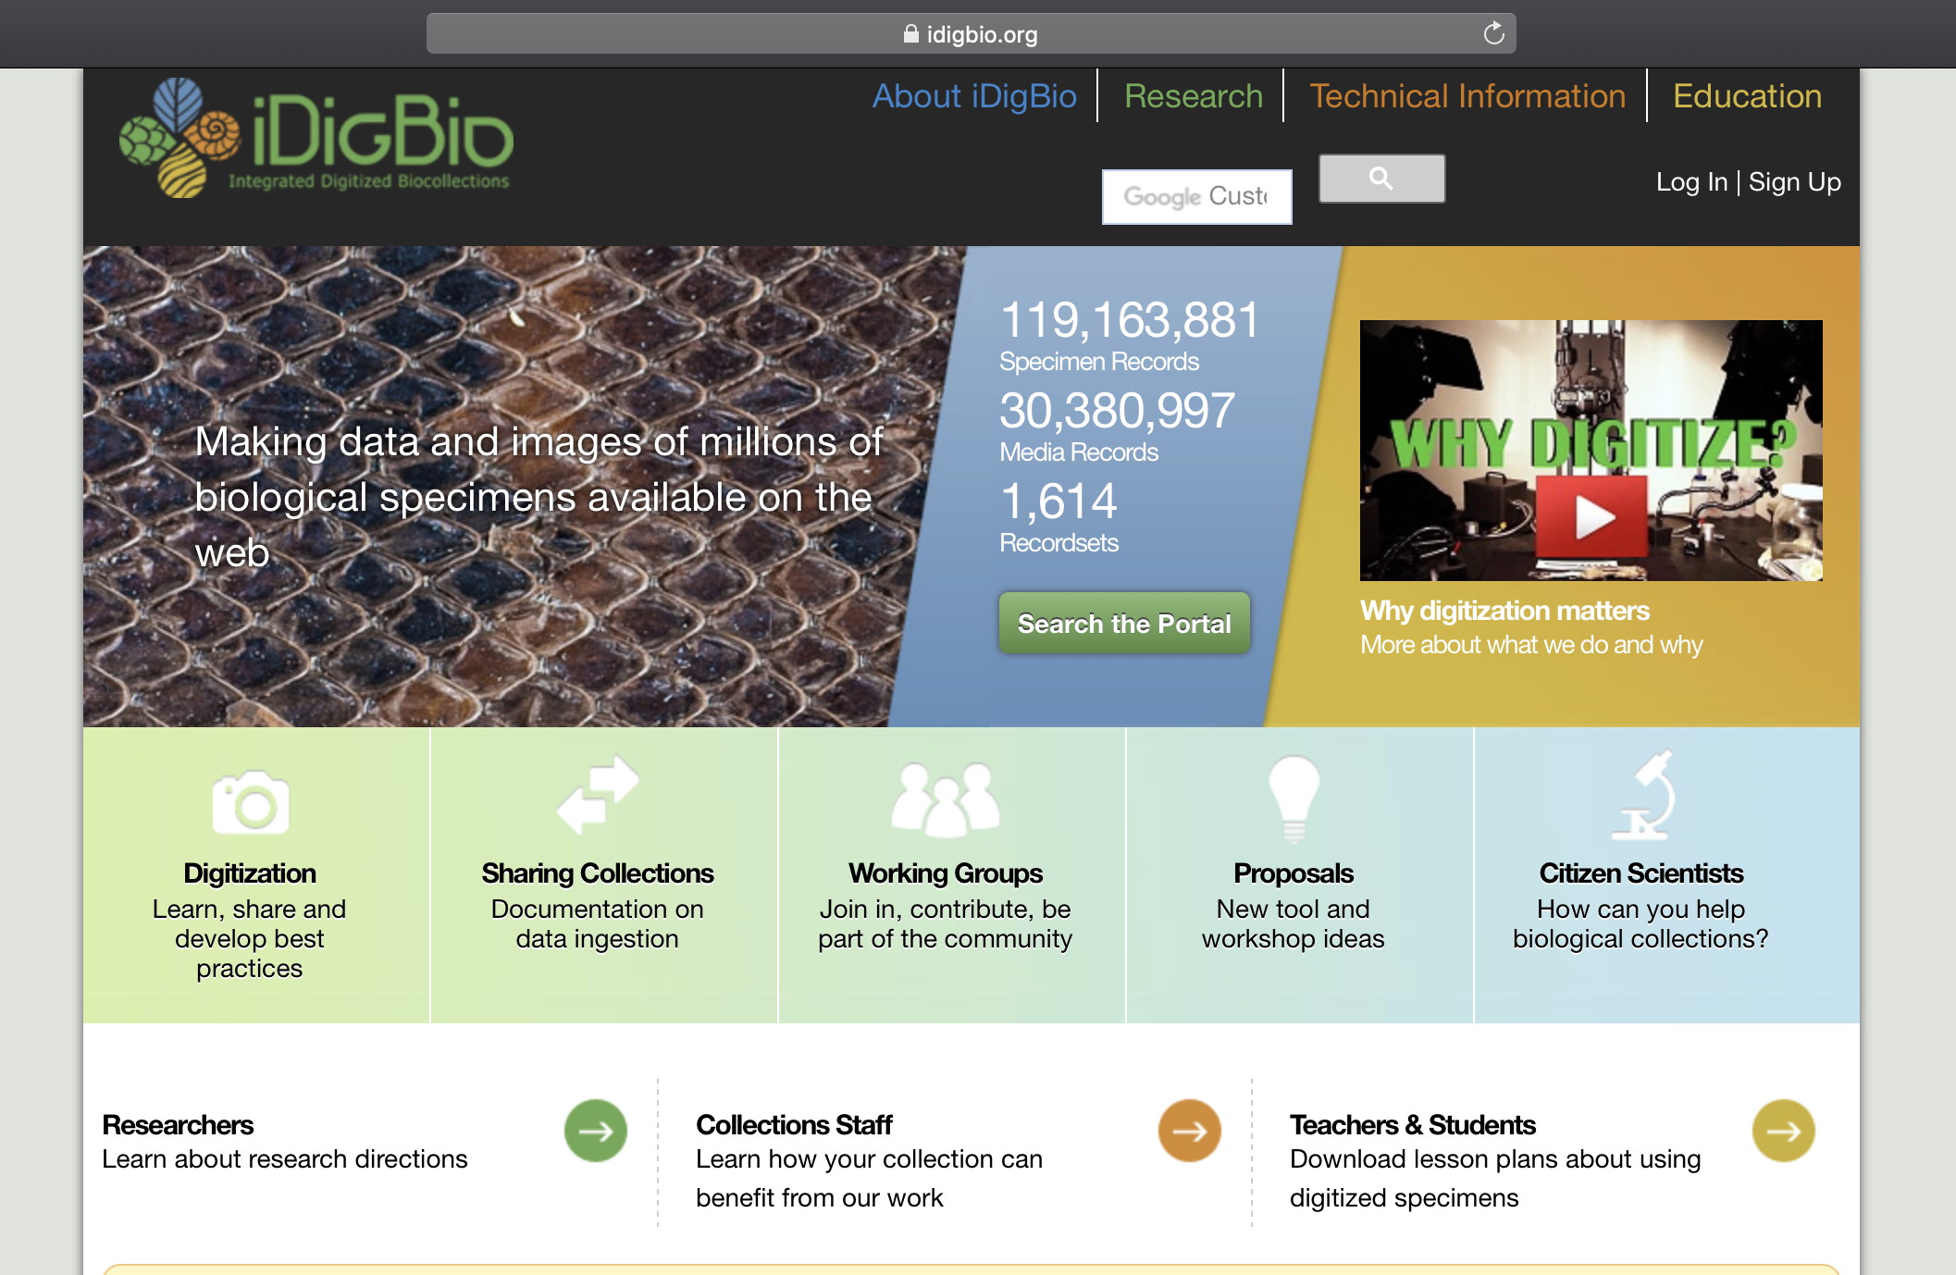


API = Application Programming Interface
Allows users to interact with a system
Web portal
API
Database
Interface

Slide 9
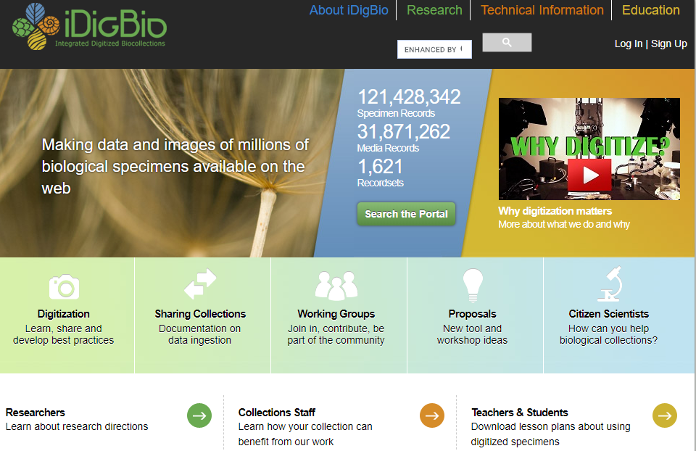

Slide 10

iDigBio API
Multiple ways to access the API:
API Name | Info
Search API | ridigbio R package <100,000 records
Download API | >100,000 records
Record API | Single record
Media API | Single record
biodiversity-specimen-data/specimen-data-use-case

Slide 11
R based
“Demo/Rbased/CrashCourse/CrashCourse.Rproj”
Navigate to 01_Download_Occurence_Data.R

Slide 12
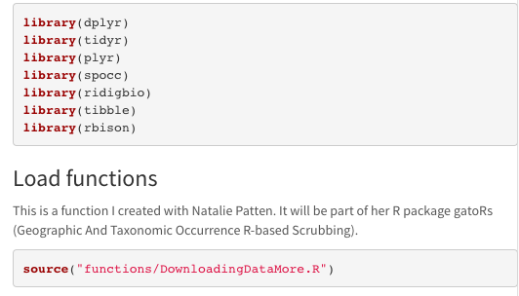





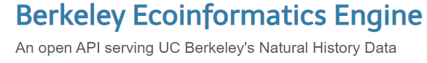
Load Packages
Notes:
spocc- Global Biodiversity Information Facility ('GBIF'), 'USGSs' Biodiversity Information Serving Our Nation ('BISON'), 'iNaturalist', Berkeley 'Ecoinformatics' Engine, 'eBird', Integrated Digitized 'Biocollections' ('iDigBio'), 'VertNet', Ocean 'Biogeographic' Information System ('OBIS'), and Atlas of Living Australia ('ALA'). Includes functionality for retrieving species occurrence data, and combining those data.
Ridigbio-Interface to the iDigBio Data API

Slide 13
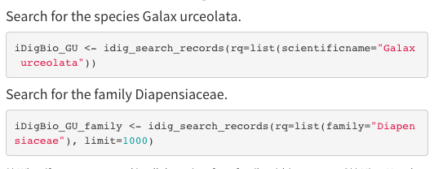
Downloading data using ridigbio
First, we are searching for the species Galax urceolata
Next, download occurrence records for the family Diapensiaceae

Slide 14
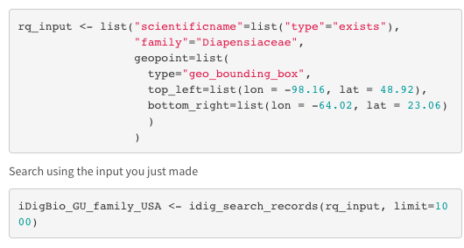
Records only in North America

Slide 15







Data download using spocc_combine
To pull data from GBIF, BISON, and iDigBio for a set of synonyms
Identifying synonyms:
Taxonomic Name Resolution Service
https://tnrs.biendata.org/
Used in soltislab/BotanyENMWorkshops 2020
R package taxize
20 sources for synonyms
https://docs.ropensci.org/taxize/

Slide 16
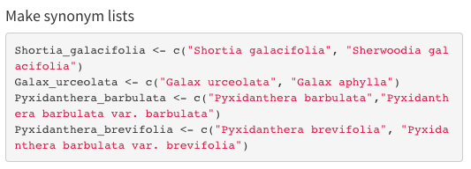
Data download using spocc_combine
Object
List of strings

Slide 17
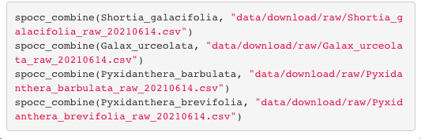
Data download using spocc_combine
(
Synonym list
,
Path to save csv file
)
spocc_combine

Slide 18
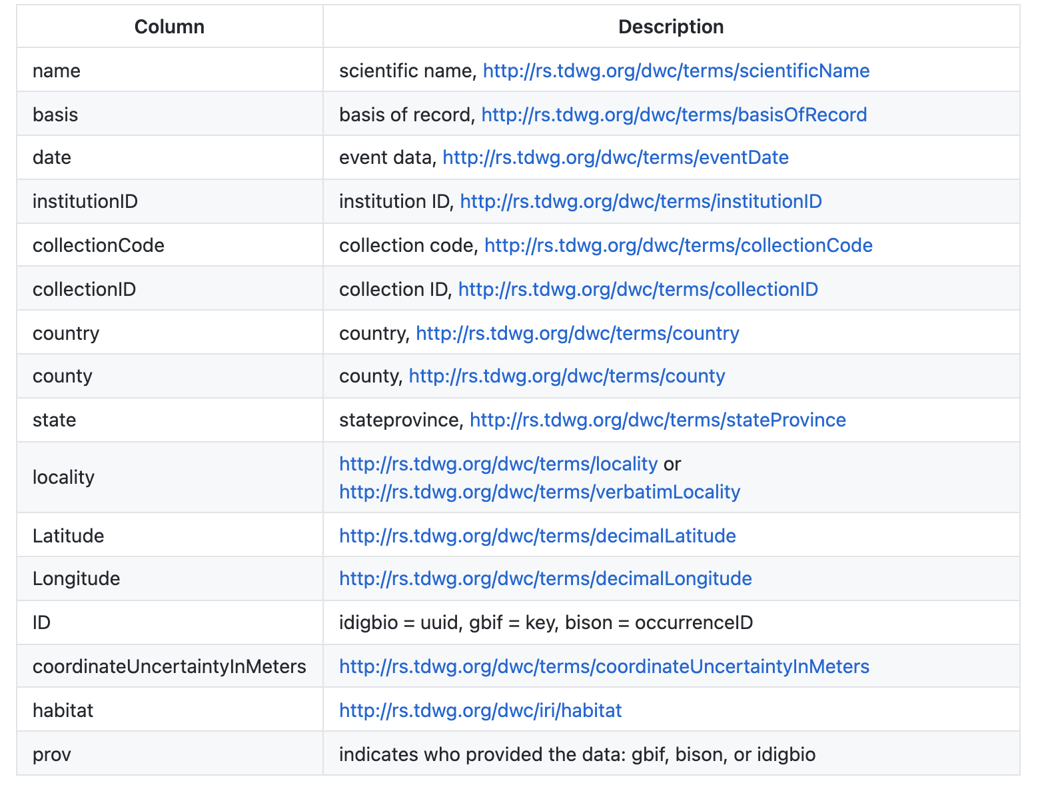

Slide 19
Other considerations:
Download from multiple repositories
Identify flagged data
Identify data for georeferencing

Slide 20
Other considerations:
Download from multiple repositories
Identify flagged data
Identify data for georeferencing
mgaynor1/CURE-FL-Plants

